Slide 1
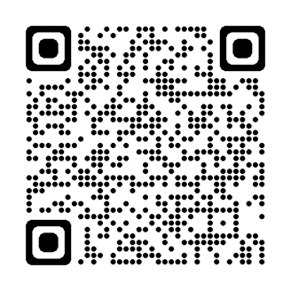
We are currently developing our new SEND Strategy and want to hear from you to help us decide the priorities for Greenwich for the next 5 years. Here is the link to our online survey OR come to our SEND “drop in” session where senior SEND officers in Greenwich and members of the Parent Forum will be available to support you in completing them and you can have a cup of tea and meet the team. On: 05/03/24 At: The Eltham Centre At: 10.30-11.45 am

